Slide 1
CSDP-499 Codrone Sim
Week #3
Nyles, Muna, Ali, Success, Sopuru

Slide 2



Deliverables
docs/ARCHITECTURE.md (1–2 pages; simple diagram + explanation)
docs/sprints/W01/plan.md
examples/00_sdk_smoke.py
sdk/tests/test_import.py
docs/PROTOCOL.md (updated to match implemented messages)
Docs/sprints/W02/plan.md
docs/presentations/W02.pdf (or W02.pptx)

Slide 3
R1 Interagator - Muna
Wrote up or sprint plans and kept up with the documentation for the project
Created a template presentation we can use going forward
Jumped around to whichever position needed the most support

Slide 4
R2 Build - Ali
Chose The Golden Machine and set it up
Golden Machine Specs:
Windows 11 Processor Intel(R) Xeon(R) w3-2435 (3.10 GHz) Graphics Card: NVIDIA RTX A4000 (16GB) Installed RAM 32.0 GB (31.3 GB usable) System type 64-bit operating system, x64-based processor Unreal Engine Version 5.7.3 Python 3.9.13
Created Set up instructions and updated as our project grew in sprint 2
Will need to be edited due to changes we decided to make due to week 2's results

Slide 5
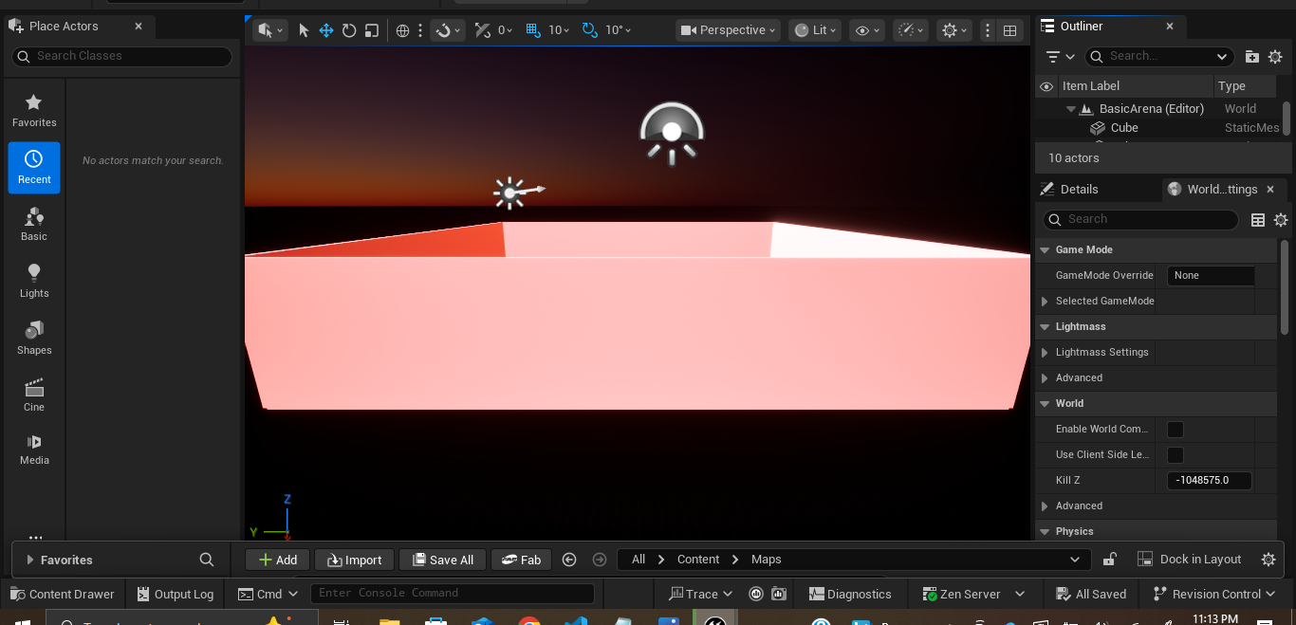
R3 World - Success
Created our 3d Drone environment in Unreal

Slide 6
R4 API - Sopuru
Created Our Template PROTOCOL.md and updated the file with current messages.
Began implementing Messages Between the SDK and unreal

Slide 7
R5 SDK - Nyles
Imported and set up Microsoft AirSim into the project
Microsoft Airsim and other SDK's are likley not going to work for this projet

Slide 8
Retrospective
What Worked:
Consistent Meeting times drastically improved productivity.
New Golden Machine runs unreal well and we can setit up with little issue.
What Didn’t Work:
Unreal ran poorly on many of our machines if it ran at all.
Microsoft AirSim SDK is outdated and no longer receiving updates.
Forces us to use outdated python versions and dependencies.
Inconsistent set up
Some machines are straight forward others do work no matter what.

Slide 9
What we plan to change next sprint
Create our own SDK
This is was our biggest bottleneck for week 2 tasks
The 3rd party SDK's are not going to work for this project and make the set up long and difficult.
Update meeting times
We need to work around balancing our meetings times a little better to make sure that we are able to get work done consistently.

